Slide 1
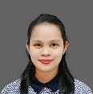
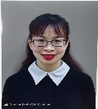
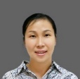
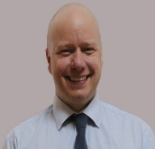
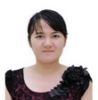
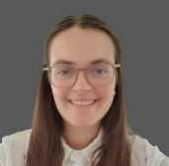
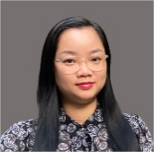
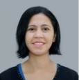
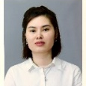
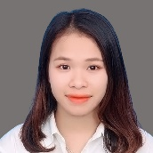
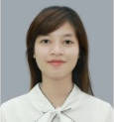
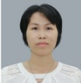
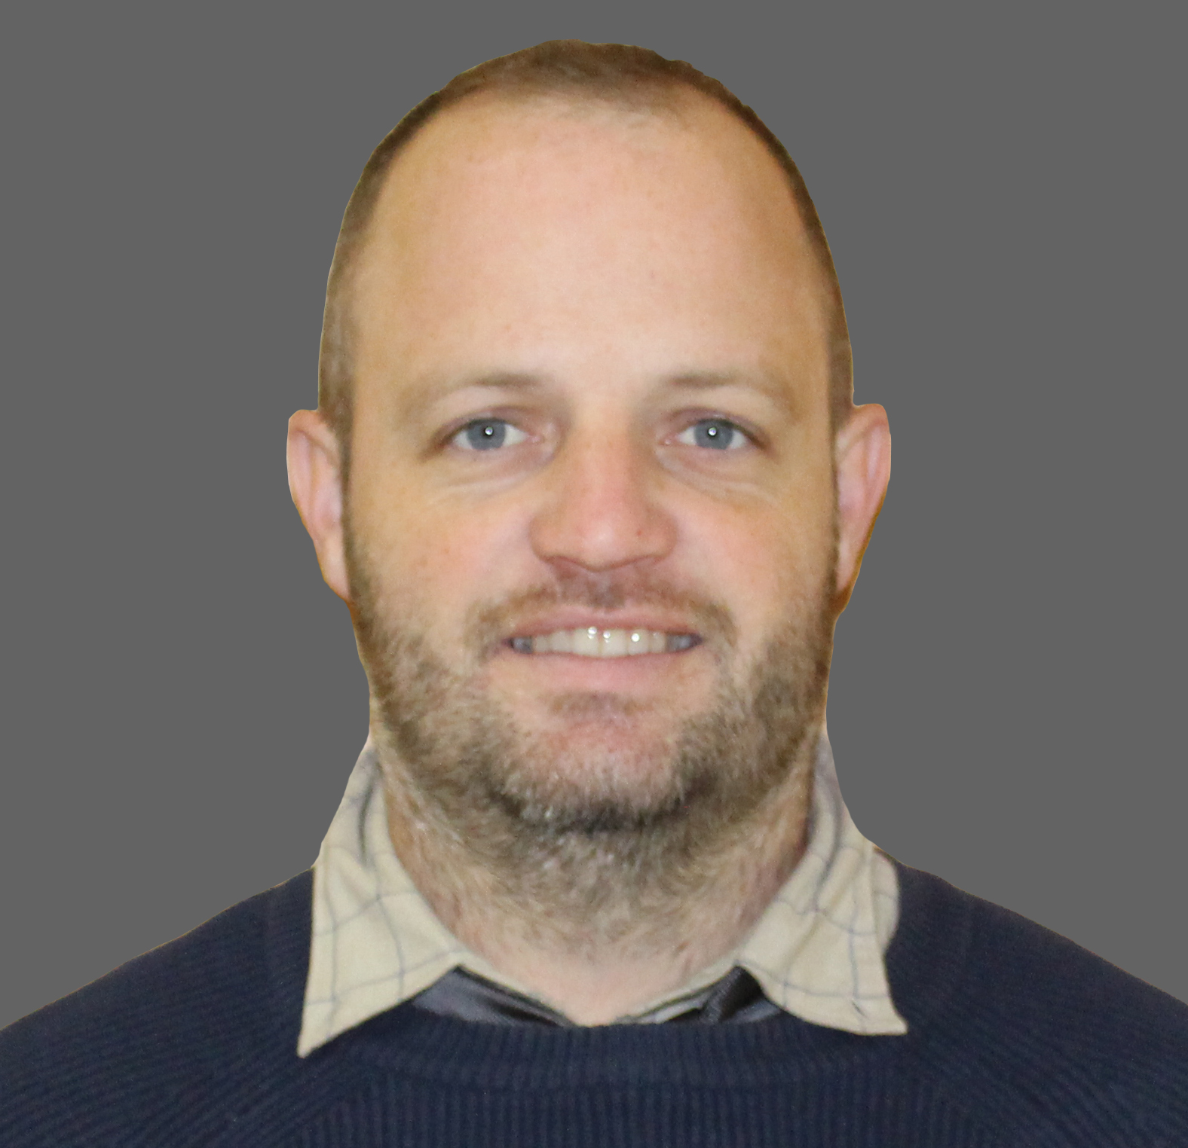
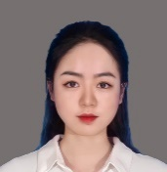
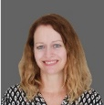
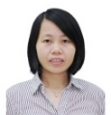
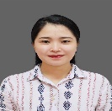
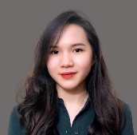
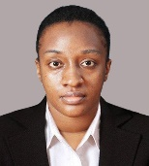
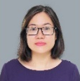
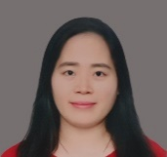
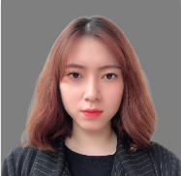
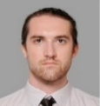
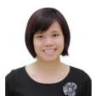
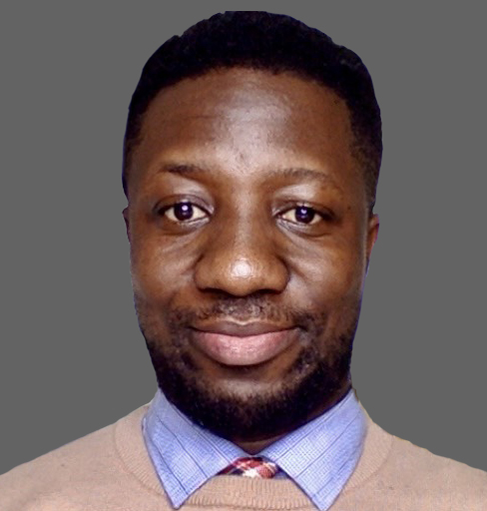
Prep
International
Teacher | Ms. MARISOL PASAJENGUE CACHO
Teacher | Ms. NGUYEN MINH CHAU
Teacher | Ms. MARISOL PASAJENGUE CACHO
Year 1
International
Teacher | Mr. STUART ANDREW COMER
Teacher | Ms. LE THI ANH NGUYET
Prep
Integrated
Teacher | Ms. NGUYEN THUY DUONG
Year 1A
Integrated
Teacher | Ms. ROBYN ALEXANDRA BEER
Teacher | Ms. LE THI SANG
Year 2
International
Teacher | Ms. PIER STEVENS
Teacher | Ms. TRAN THI LAN ANH
Teacher | Ms. LE BICH NGOC
Primary Class
Teachers
Year 2A
Integrated
Teacher | Ms. ROBYN ALEXANDRA BEER
Teacher | Ms. NGUYEN HONG THINH
Year 3
International
Teacher | Ms. ELAINE MARIE COLEMAN
Teacher | Ms. PHAN THI HA
Year 3A
Integrated
Teacher | Mr. Mr. NEIL MARTIN HINEY
Teacher | Ms. VU THU TRANG
Teacher | Ms. PHAN LAN HUONG
Year 4A
International
Teacher | Ms. SARAH ANNE BASH
Year 4A
Integrated
Teacher | Ms. MELODY TUBALLA
Teacher | Ms. PHAM PHUONG THAO
Year 4B
International
Teacher | Ms. SUSAN ANN WANJIRU KIMANI
Teacher | Ms. NGUYEN THI SON THUY
Year 4B
Integrated
Teacher | Ms. MELODY TUBALLA
Teacher | Ms. PHAM THI LAN ANH
Year 5
International
Teacher | Ms. SAMUEL JAMES BURNE
Year 5
Integrated
Teacher | Mr. NEIL MARTIN HINEY
Teacher | Ms. NGUYEN THI PHUONG ANH
Teacher | Ms. HOANG THI HONG
Year 6
International
Teacher | Mr. BENJAMIN KORANG

Slide 2
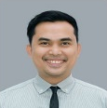
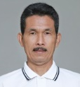
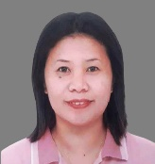
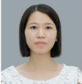
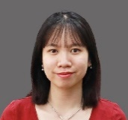
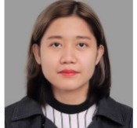
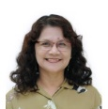
Music
Teacher | Mr. RICARDO BESANA
Class | All Classes
PE
Teacher | Mr. WILLIAM MODESTO SANTOS MASANGKAY
Class | All Classes
Primary
Specialist
Teachers
ICT
Teacher | Ms. RAQUEL BIGTAS CARINGAL
Class | All Classes
Chinese
Teacher | Ms. NGUYEN THI NHUNG
Class | All Classes
Teacher | Ms. NGUYEN THANH HA
Class | All Classes
EFL
Teacher | Ms. MICHELLE TRUMATA GRAVA
Class | All Classes
Teacher | Ms. SUSANA ESTILLER ZULUETA
Class | All Classes

